Slide 1

MULTIPROGRAMMED SERVER Performance Evaluation of Computer System and Networks
Califano Tommaso • Ramacciotti Nicola • Suma Gabriele
Master degree in Computer Engineering, 1st year
Year 2023/24, fall term

Slide 2
Table of contents
01
02
03
04
05
Overview
Model
Implementation
Objectives and key performance indexes
Theoretical model, assumptions and factors
Omnet++ model and verification tests
Data Analysis
Conclusion
Calibration and simulations scenarios

Slide 3
01
Overview

Slide 4
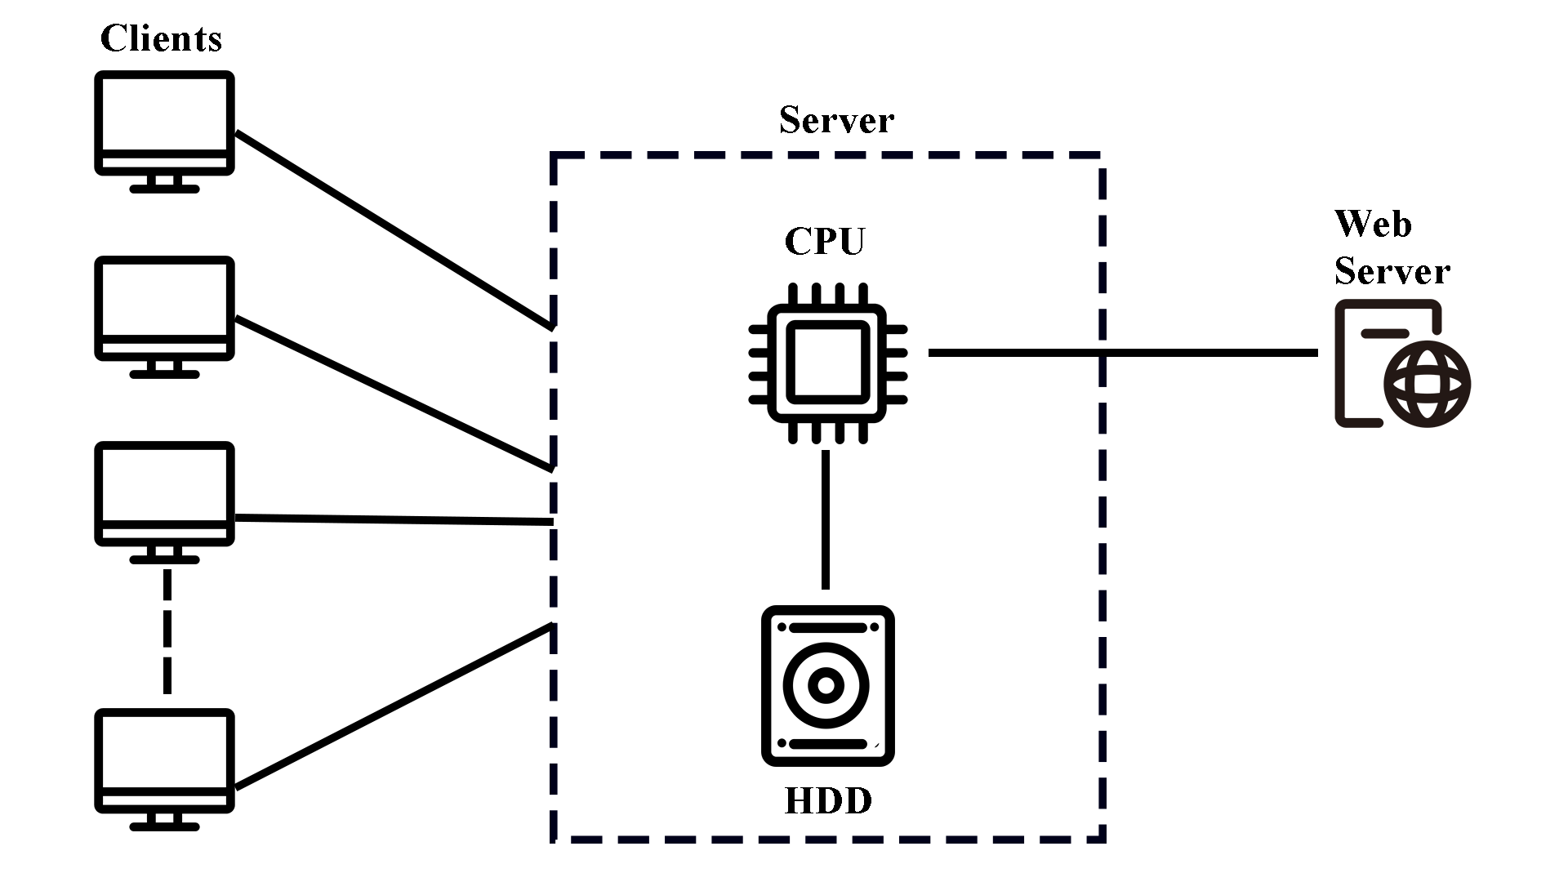
Overview
Objectives:
Throughput
Utilization
Key performance indexes:
Throughput: the number of completed transactions per unit of time.
Utilization: the time percentage during which each node is busy.

Slide 5
02
Model

Slide 6
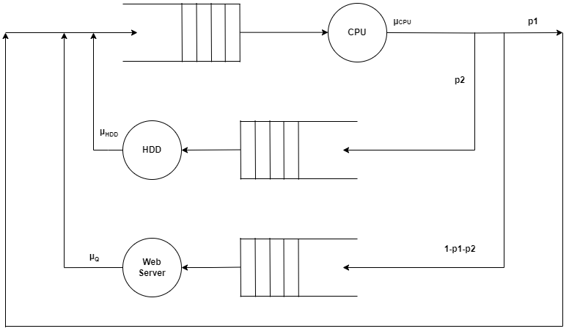
Model
Assumptions
Finite number of clients = number of jobs within the system.
Infinite queue size
Service centers: exponential distributed service time with a different rate and FIFO order processing.
p2
µ_{HDD}
Factors
N
µ_{CPU}
p1
µ_{WS}

Slide 7
03
Implementation

Slide 8
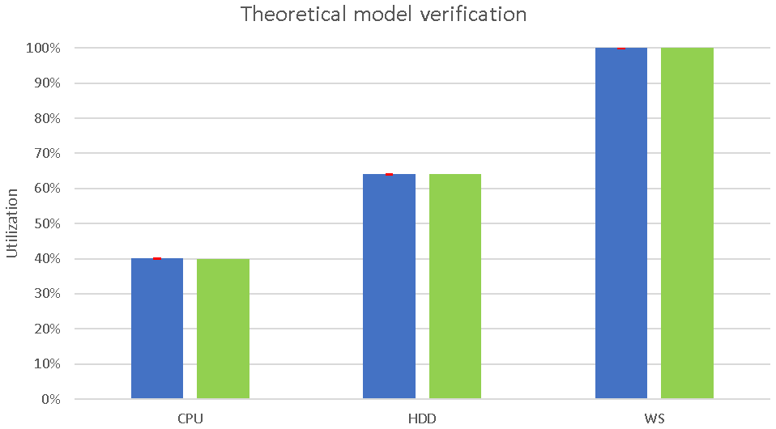
Omnet++ Model
Server
Client
CPU
HDD
Confidence level: 99%
Empirical utilization
Web Server
Theoretical utilization

Slide 9
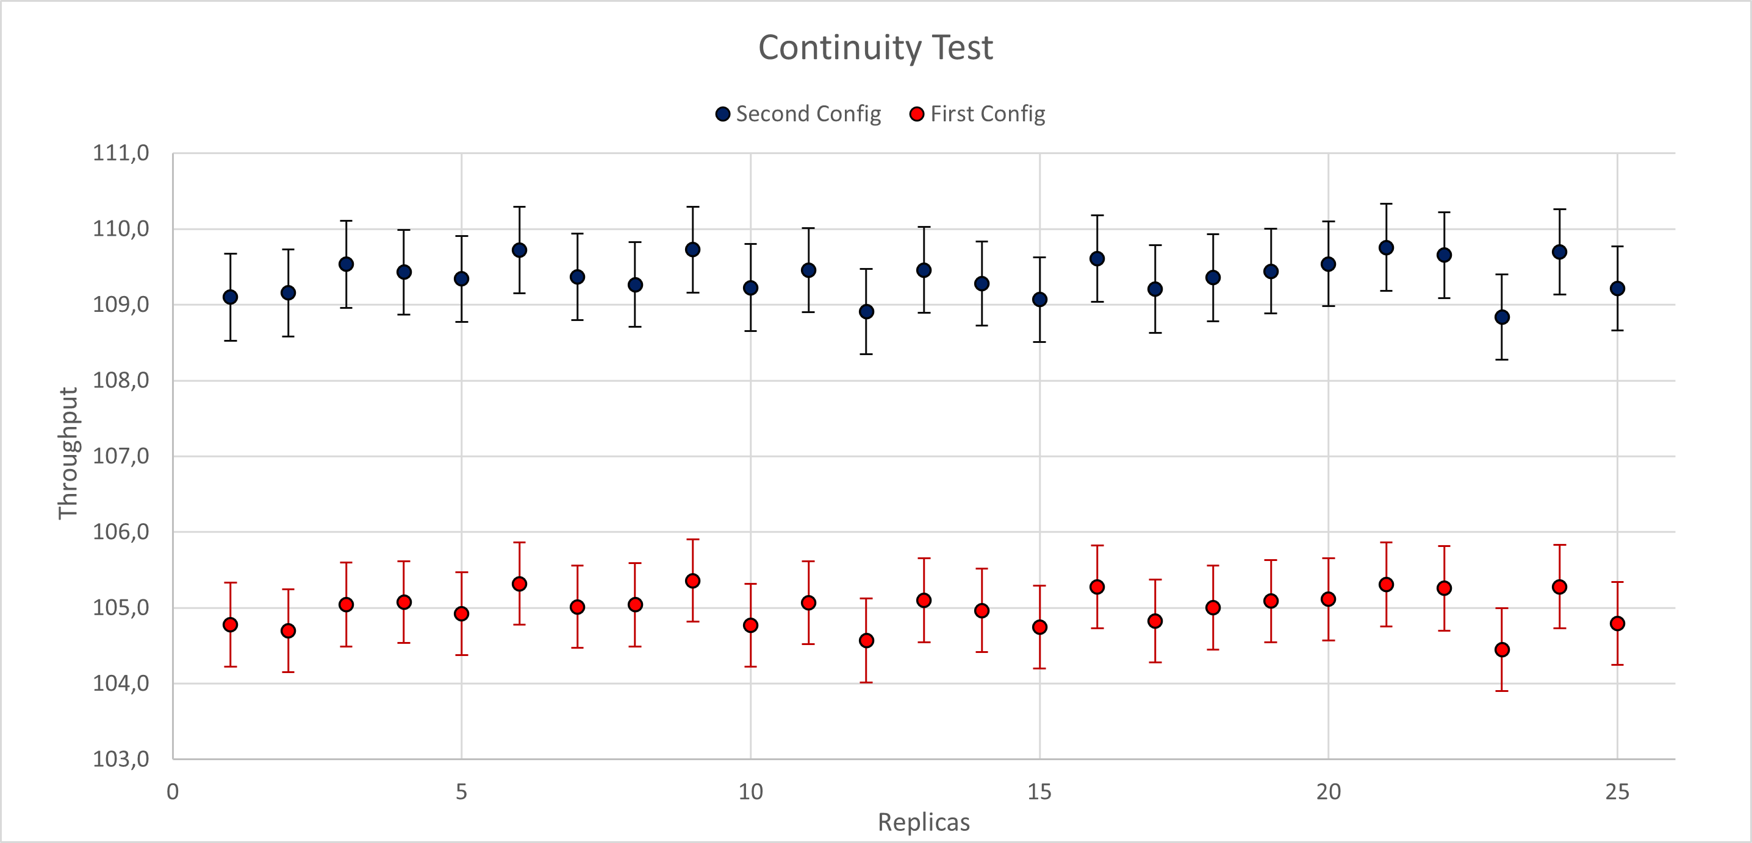
Verification
Continuity Test
Second Config
p1 = 0.35 | µ_{CPU} = 1000
p2 = 0.41 | µ_{HDD} = 250
 | µ_{WS} = 75
Number of clients = 40
First Config
p1 = 0.35 | µ_{CPU} = 1000
p2 = 0.40 | µ_{HDD} = 250
 | µ_{WS} = 75
Number of clients = 40
Confidence level: 95%

Slide 10
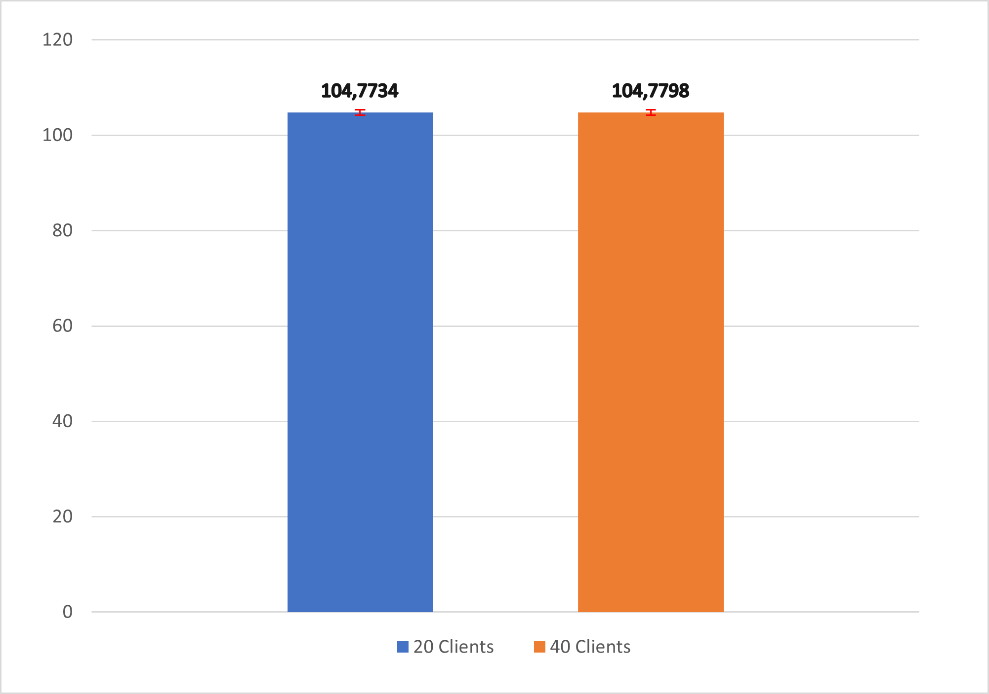
Verification
Consistency Test
Common Values
p1 = 0.35 | µ_{CPU} = 1000
p2 = 0.40 | µ_{HDD} = 250
 | µ_{WS} = 75
20 Clients
40 Clients
Confidence level: 95%

Slide 11
04
Data Analysis

Slide 12
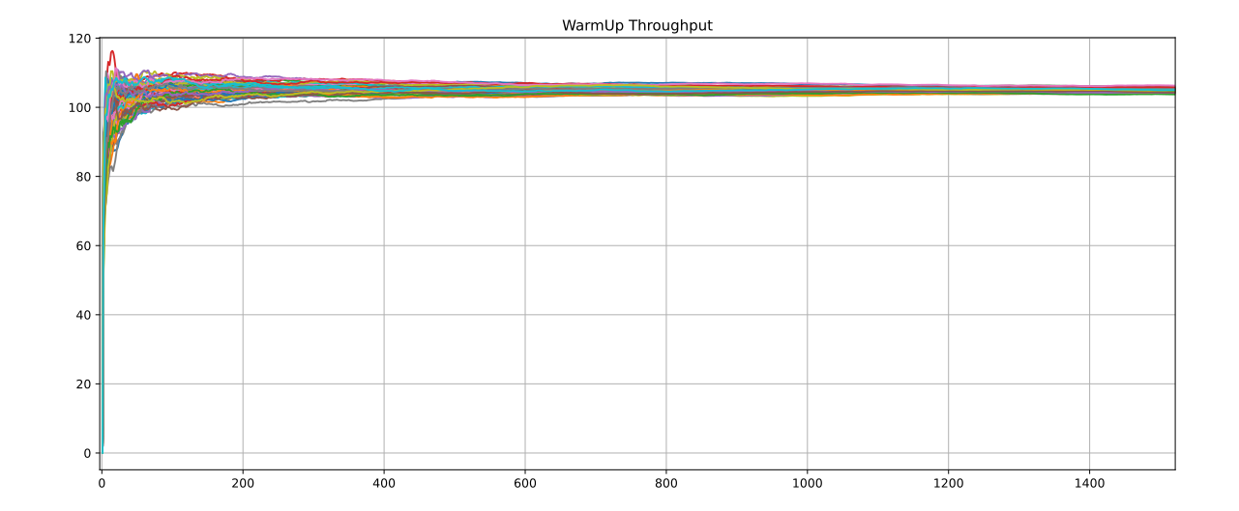
Calibration
Warm-up evaluation
Repetitions
The experiment was based on 100 repetitions
Gathered data
All data were analyzed with time average function
Final Value
500s warm-up period

Slide 13
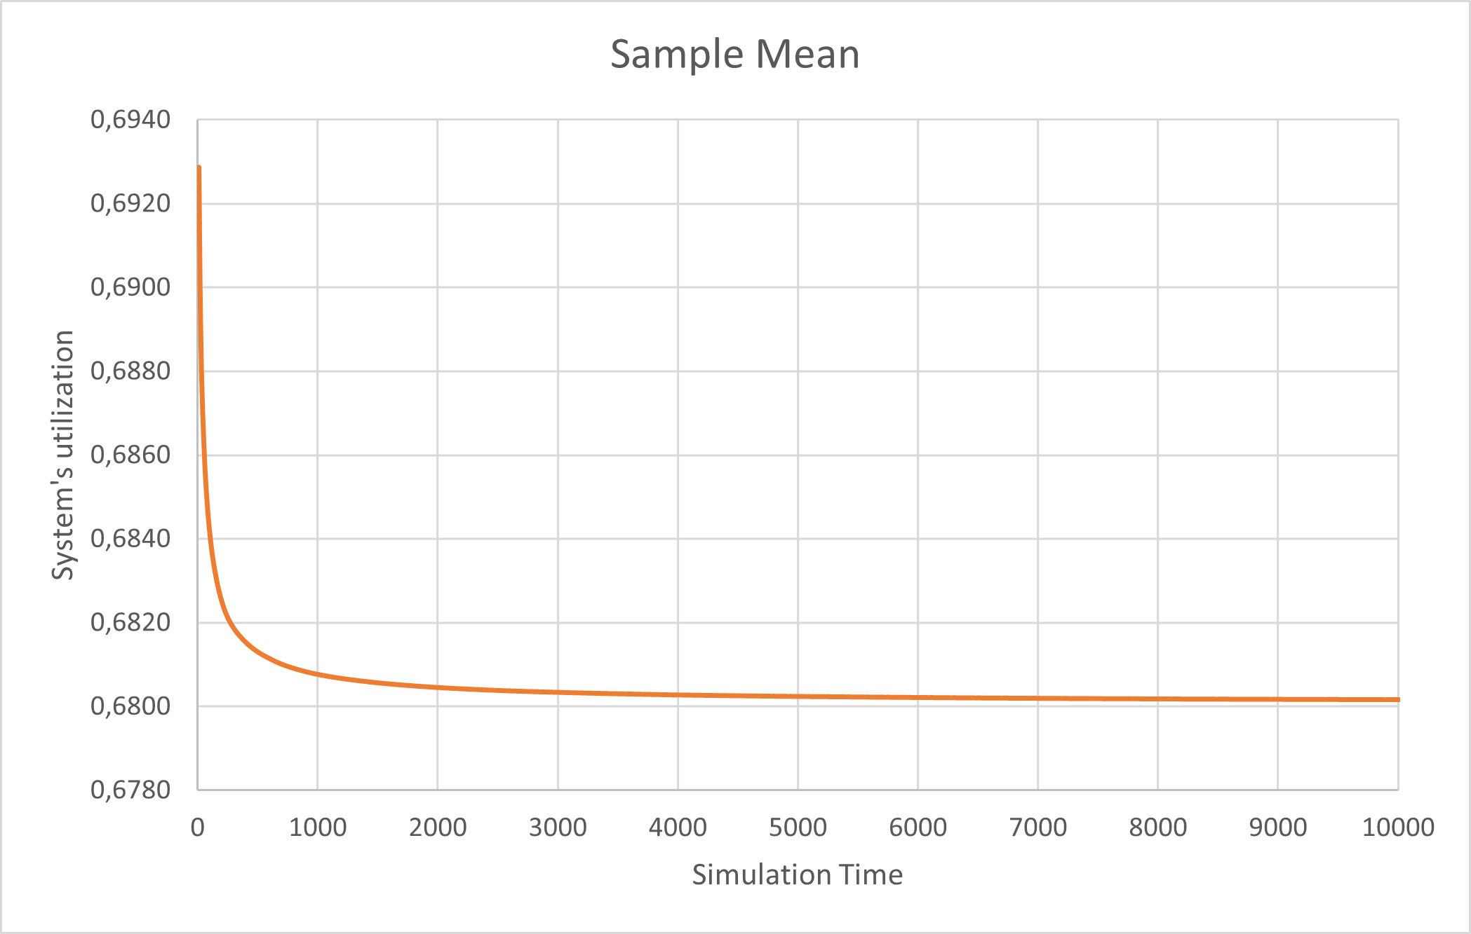
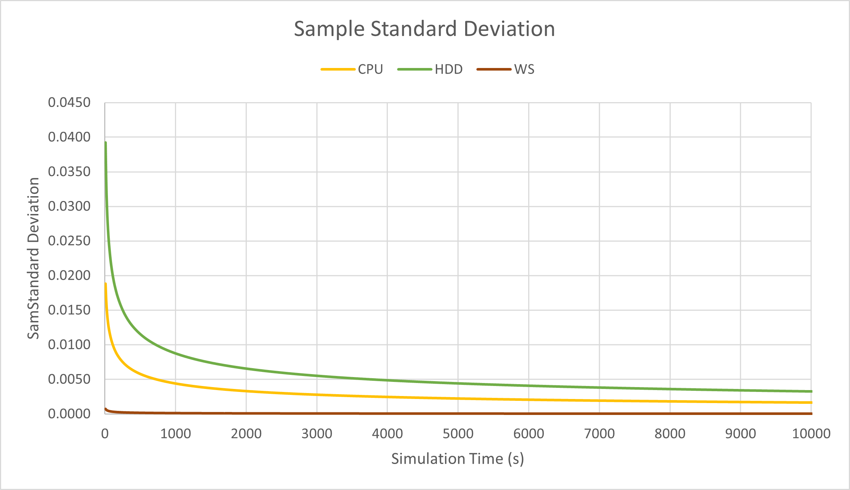
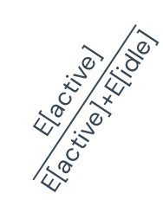
Calibration
Simulation Time
Repetitions
Theoretical Verification
Final Value
500 repetitions
Sample mean & Sample Standard Deviation
Gathered Data
The sample mean converges to
4000s simulation time
$$\frac{\text{E}\text{[}\text{active}\text{]}}{\text{E}\text{[}\text{active}\text{]+}\text{E}\text{[}\text{idle}\text{]}}$$

Slide 14
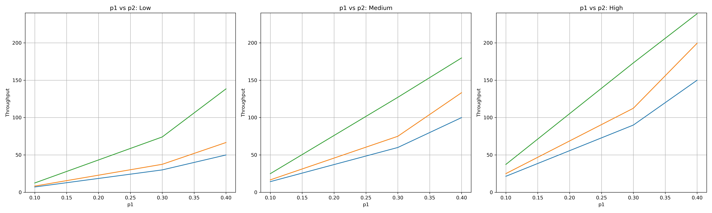
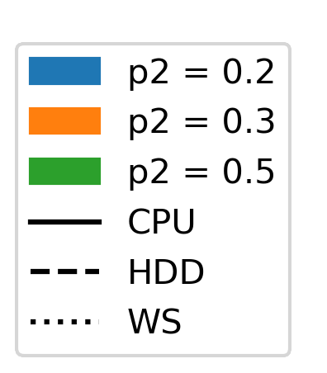
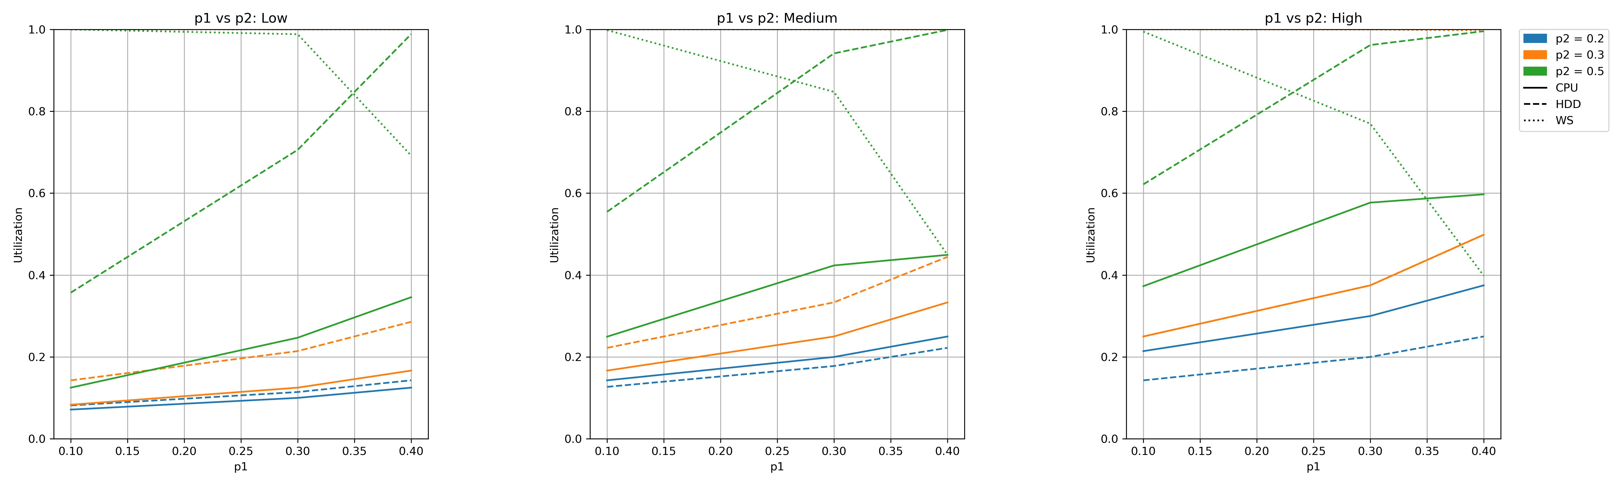
Simulation Scenarios: p1 vs p2
Low
Medium
High

Slide 15
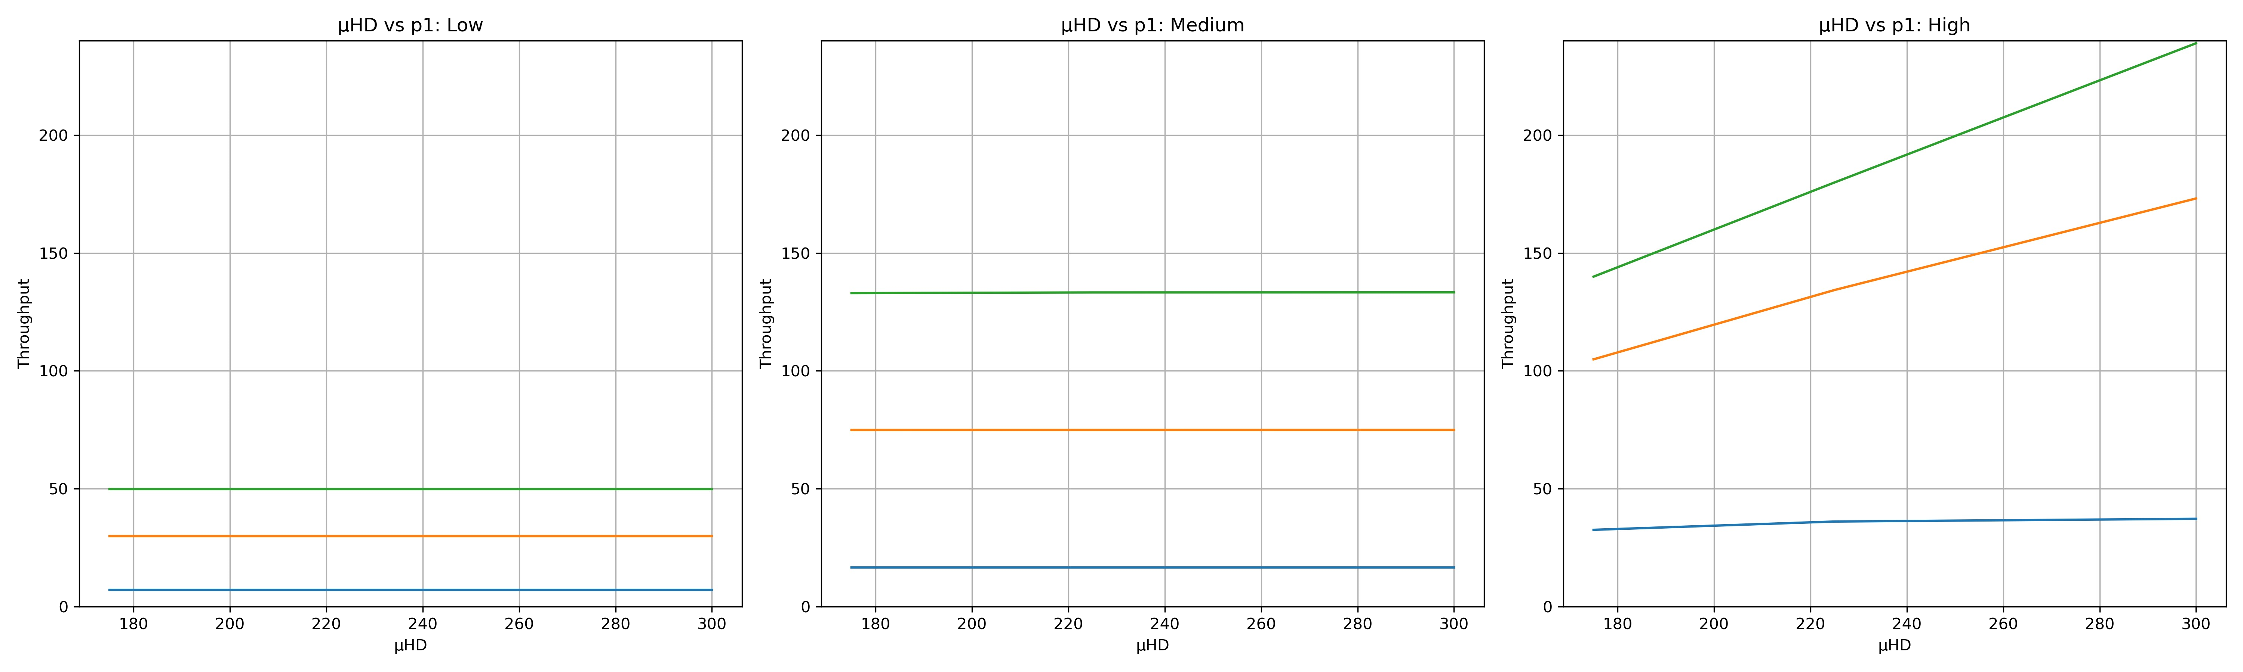
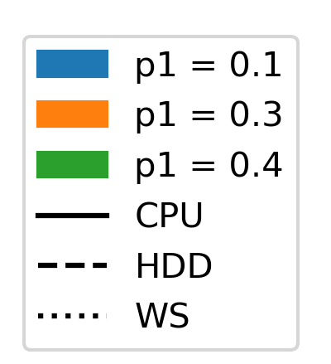
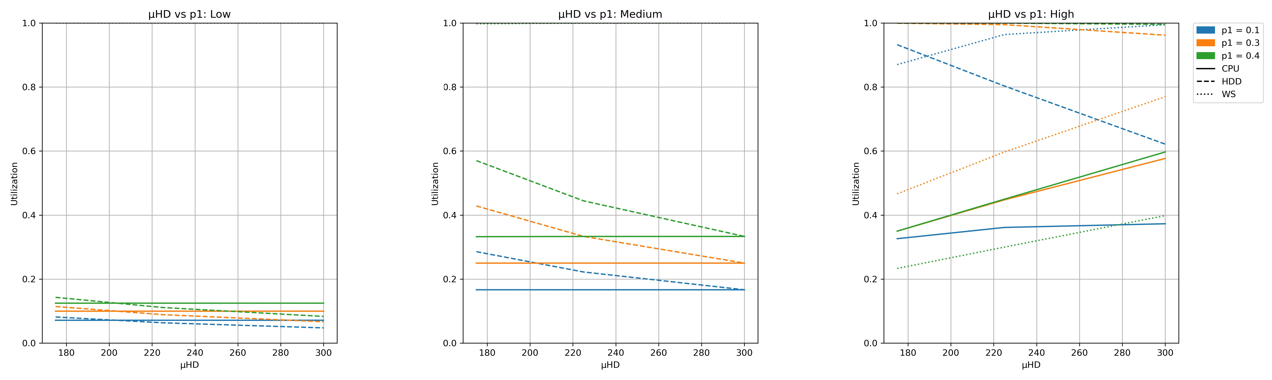
Simulation Scenarios: µ_{HDD} and p1
Low
Medium
High

Slide 16
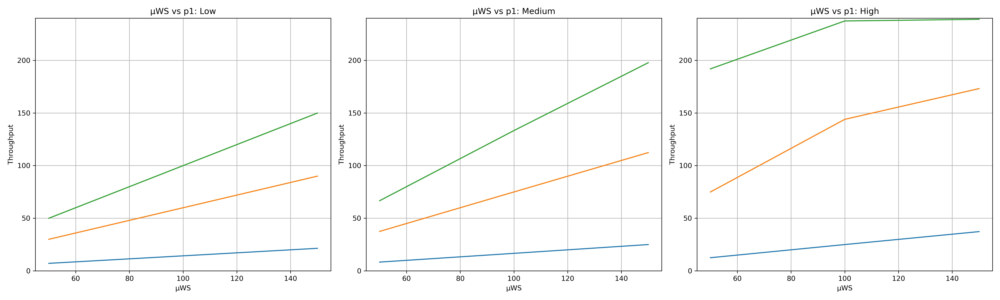
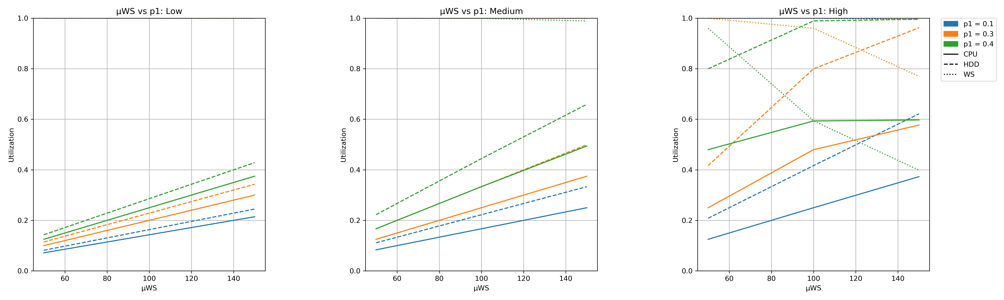
Simulation Scenarios: µ_{WS} and p1
Low
Medium
High

Slide 17
05
Conclusions

Slide 18
Conclusions

Slide 19
Thanks!

